Slide 1
PFT Interpretation
Darrin Hursey, MD

Slide 2
Overview
Indications for performing PFTs
Brief review of relevant pulmonary physiology
Interpretation scheme

Slide 3
Indications
Evaluation of chronic dyspnea (looking specifically for asthma or COPD)
Monitoring for response to therapy for asthma or COPD
Pre-operative evaluation

Slide 5
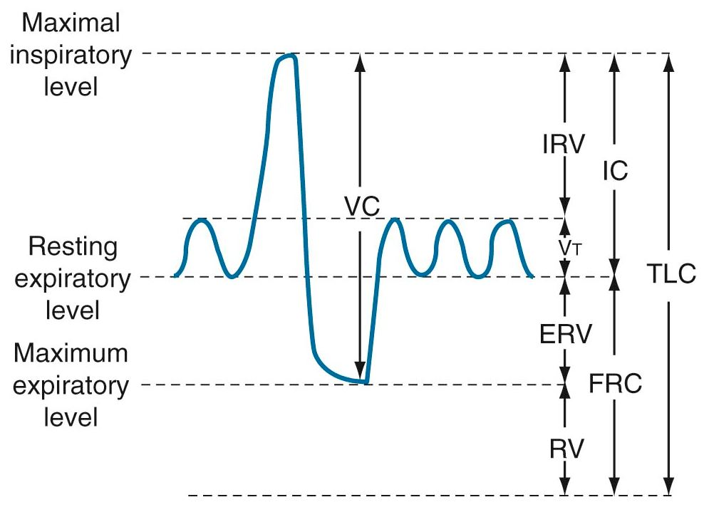
Lung volumes and capacities
Murray and Nadel’s Textbook of Respiratory Medicine, 6th Edition

Slide 6
Lung volumes
Vt = tidal volume
IRV = inspiratory reserve volume
ERV = expiratory reserve volume
RV = residual volume

Slide 7
Lung capacities
IC = inspiratory capacity = Vt +IRV
FRC = functional residual capacity = ERV + RV
TLC = total lung capacity = FRC + IC

Slide 8
Interpretation
First, ensure test is valid
Patient must exhale for 6 seconds for test to be valid
Read therapist’s notes to make sure patient was able to perform the test properly
Make sure the test is reproducible
Spirometry, lung volumes, flow-volume loop, and DLCO are then evaluated

Slide 9
Interpretation
Assess for obstruction by looking at the FEV1/FVC ratio
FEV1/FVC <0.7 consistent with obstruction
If obstruction present, severity is graded by FEV1 %predicted
>80% = mild = GOLD I
50-80% = moderate = GOLD II
30-49% = severe = GOLD III
<30% = very severe = GOLD IV

Slide 10
Interpretation
Next, assess for restriction by looking at FVC
FVC < 80% predicted suggests restriction (assuming FEV1/FVC >0.7)
Lung volumes are needed to verify
TLC <80% predicted verifies restriction

Slide 11
Interpretation
If FEV1/FVC <0.7, but FVC also reduced, this is probably due to hyperinflation and air-trapping.
Need lung volumes to verify
Normal TLC (especially with elevated RV) verifies hyperinflation
TLC <80% consistent with mixed defect

Slide 12
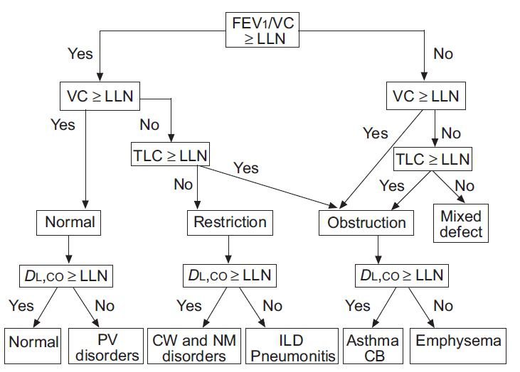
Interpretation
Eur Respir J 2005; 26

Slide 13
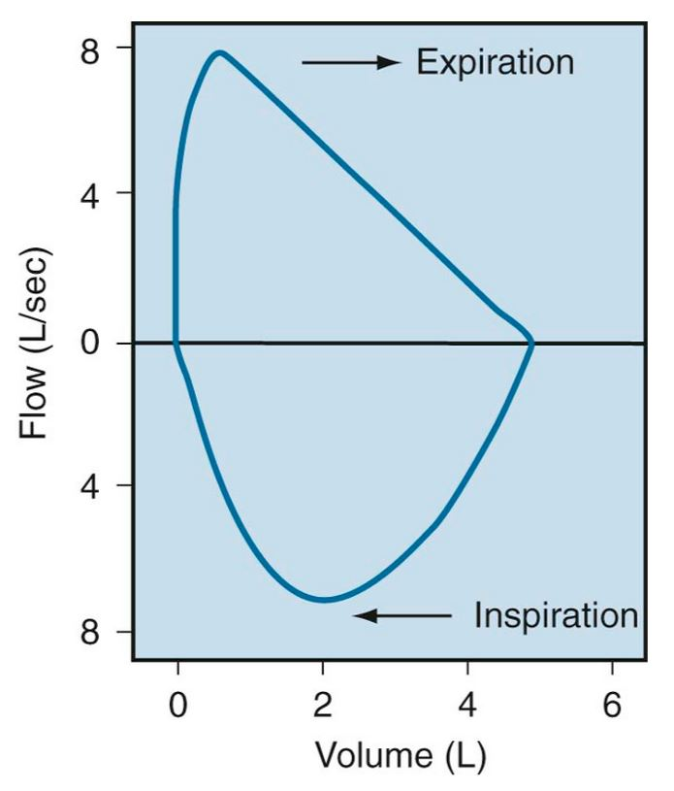
Flow-volume loop
Murray and Nadel’s Textbook of Respiratory Medicine, 6th Edition

Slide 14
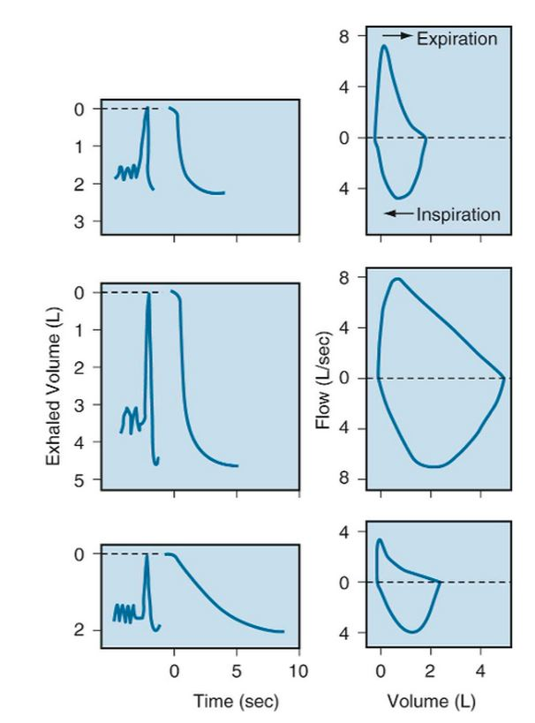
Flow-volume loop
Murray and Nadel’s Textbook of Respiratory Medicine, 6th Edition

Slide 15
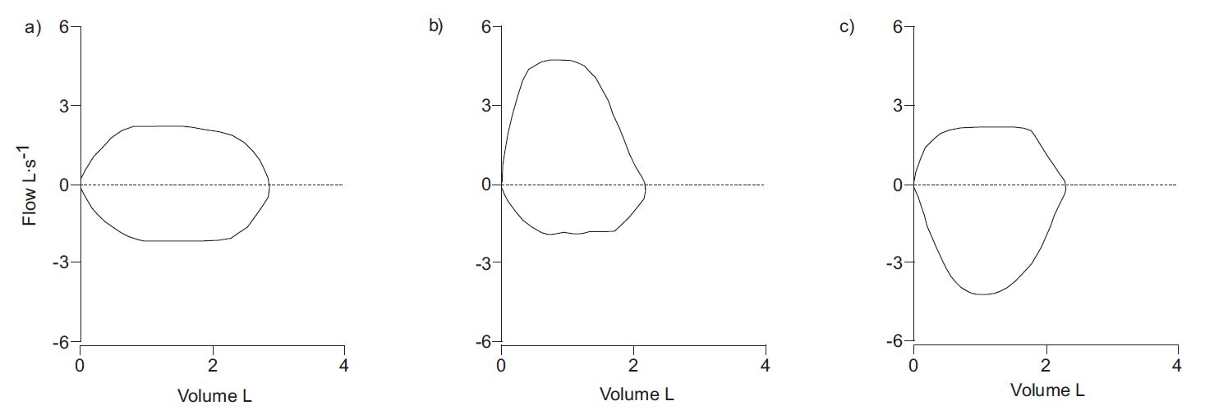
Flow-volume loop
Eur Respir J 2005; 26

Slide 16
DLCO
Assesses gas exchange
Must be adjusted for hemoglobin level
Can also be adjusted for alveolar volume
Can add diagnostic information, but is difficult to perform and can be quite variable

Slide 17
DLCO
Decreased DLCO with normal spirometry suggests pulmonary vascular disease, pulmonary embolism, or combined ILD + emphysema
Decreased DLCO with obstruction suggests emphysema rather than asthma

Slide 18
DLCO
Normal DLCO with restriction suggests neuromuscular weakness, chest wall deformity, etc. rather than ILD
Elevated DLCO seen in asthma and pulmonary hemorrhage

Slide 20
Further reading
Broaddus, VC, Mason, RJ, Ernst, JD, King, TE, Lazarus, SC, Murray, FJ, Nadel, JA, Slutsky, AS, Gotway, MB 2015 Murray & Nadel’s Textbook of Respiratory Medicine, 6th edition, Elsevier Saunders, Philadelphia PA.
R. Pellegrino, G. Viegi, V. Brusasco, R.O. Crapo, F. Burgos, R. Casaburi, A. Coates, C.P.M. van der Grinten, P. Gustafsson, J. Hankinson, R. Jensen, D.C. Johnson, N. MacIntyre, R. McKay, M.R. Miller, D. Navajas, O.F. Pedersen and J. Wanger 2005 “Intepretive strategies for lung function tests” Eur Respir J, 26, 948–968

