Slide 1
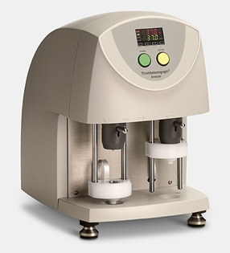
Thrombelastograph® (TEG®) Coagulation Analyzer
Tobin Timmons
TEG Clinical Specialist
Haemonetics Corporation

Slide 2
What is TEG®?
A real time analyzer of whole blood for coagulation
Measures the viscoelastic properties of the hemostasis process functionally, the end-result being the hemostatic plug, or clot
The clot has three main systems and five affecting processes...

Slide 3
Systems Evaluated With TEG
Physiologic
Pathologic: Primary & Secondary
Activation / Aggregation

Slide 4
Objectives of TEG-Guided Therapy
  To express function and pinpoint dysfunction in the hemostasis system
    Reference the appropriate types and amounts of blood products needed to correct bleeding from this dysfunction
    Allow accurate anticoagulation or antiplatelet interventions to reduce thrombotic complications without inappropriate bleeding

Slide 5
Objectives of TEG-Guided Therapy (Cont.)
To distinguish between anatomical and coagulopathic bleeding
To distinguish primary from secondary fibrinolysis, including the consumptive phase
To reduce the use of unnecessary blood products and reduce thrombotic complications

Slide 6
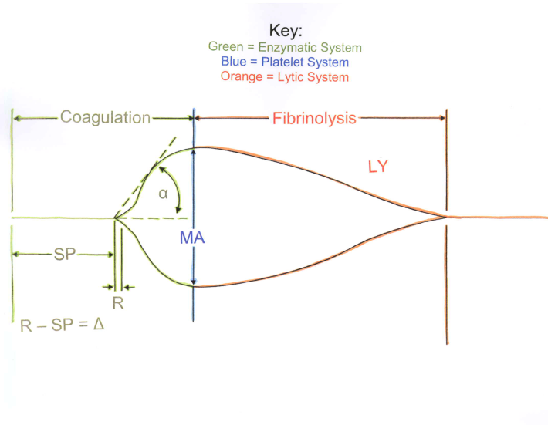
K
EPL, LY30
= Platelet function
R
G = Clot Strength
R = Reaction time to end of thrombin burst
K = fibrin cross-linkage, fibrinogen function
Angle = fibrinogen function
MA = platelet function in mm
G = MA converted to Kdynes/cm²
EPL = Estimated Percent Lysis, clot breakdown
LY30 = Lysis 30 minutes after MA reached

Slide 7
Hemostasis Monitoring with TEG
Platelet Count
Hemostatic
status
PT/INR
PTT
Bleeding
Time
D-dimer
FDP
Traditional Hemostasis Tests
Do not define the overall process, just provide pieces of the process!

Slide 8
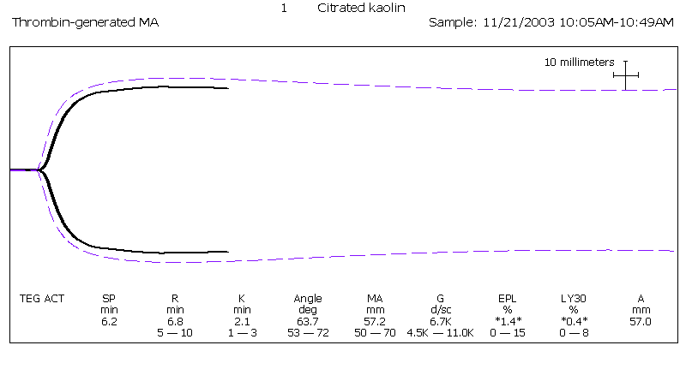
Normal TEG® Tracing

Slide 9
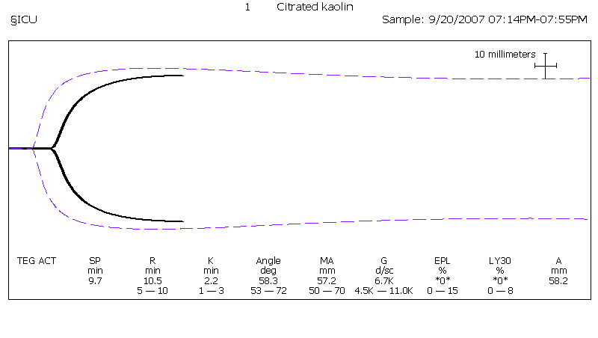
Hemodilution/Anticoagulants

Slide 10
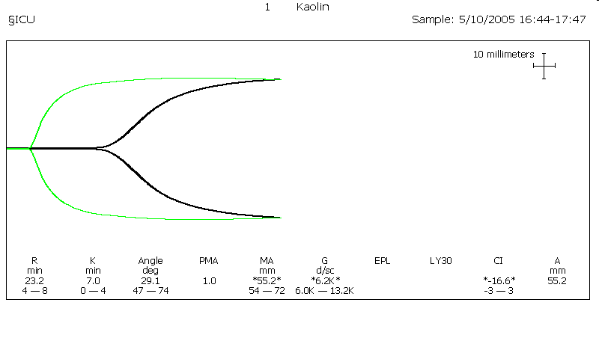
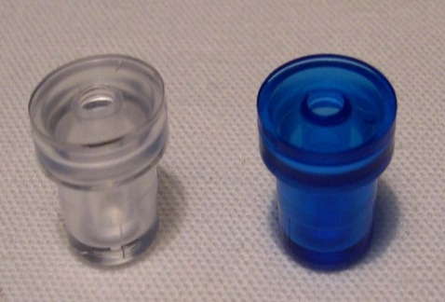
Heparin Effect
Heparinase cup
Plain cup
5.8 2.2 59.1 0.0 56.2 6.4 *2.0* *0.4* -1.0 55.0
Notes:
Explain the use of plain and heparinase cup to see heparin effect. ********Changed color of data to match heparinase tracing.

Slide 11
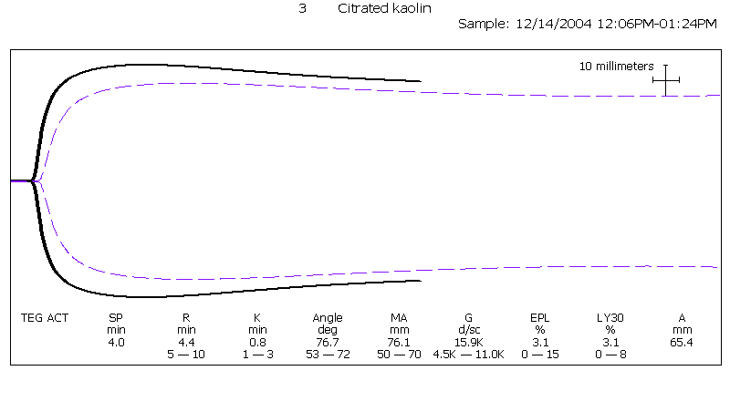
Combination Hypercoagulability
Notes:
Which came first? How can we know for sure?

Slide 12
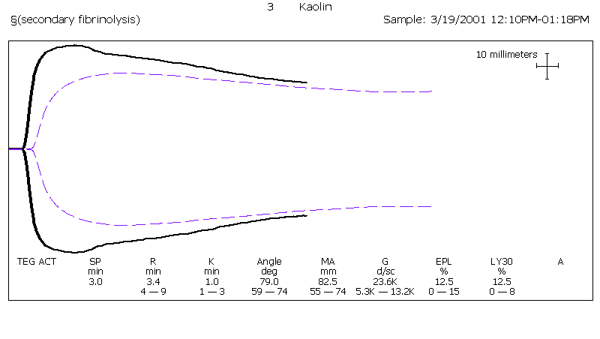
Secondary Fibrinolysis, Stage I DIC
Notes:
This tracing presents information that can be interpreted with the strongest indication towards stage I DIC. Typically nothing else should cause this tracing (other than mechanical issues).

Slide 13
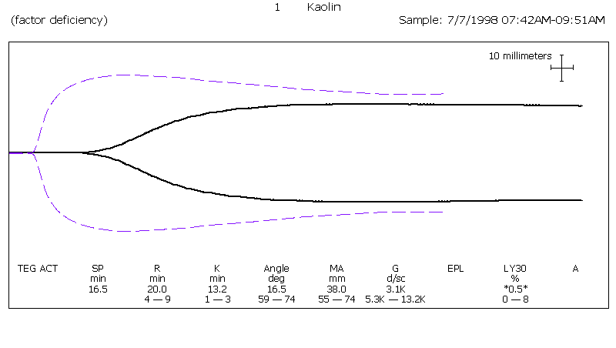
Secondary Fibrinolysis, Stage II DIC
Notes:
This tracing presents information that could be interpreted as indicating hypcoagulablility throughout with no significant lysis. The information presented could also be interpreted or indicate that it is not Stage II DIC because it could also be things like overanticoagulation or severe factor deficiency.

Slide 14
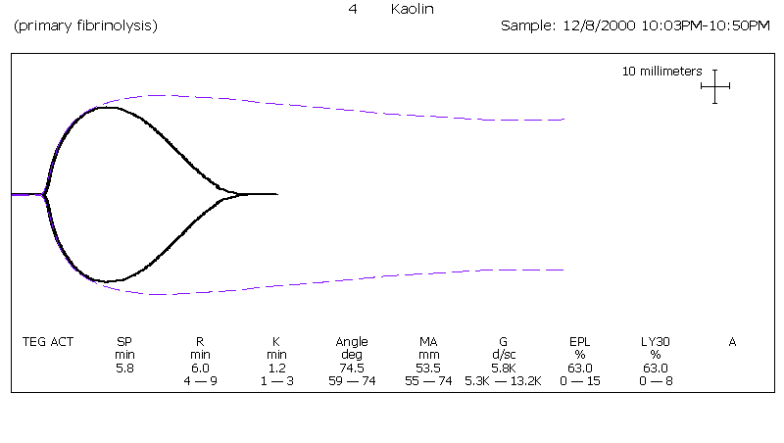
Primary Fibrinolysis - TEG® Tracing

Slide 15
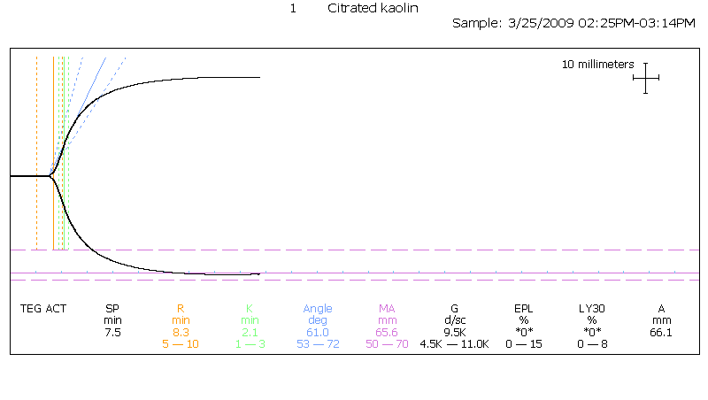
Normal TEG® Analysis
INCLUDES:
Heparin
LMWH
Coumadin
Arixtra®
Pradaxa®
Xarelto®
Factor Deficiency
Fibrinogen Deficiency
Platelet Function
Clot Strength
Lysis
Surgical Bleeding from Hemostasis
Hypercoagulability
EXCLUDES:
Plavix®
Effient®
Brilinta®
Integrilin®
Reopro®
Aggrastat
Pletal((
Persantine
NSAIDs
ASA
Pathologic Platelet Inhibition

Slide 16
PlateletMapping® Assay
Monitoring Platelet Inhibition and Baseline Platelet Function

Slide 17
PlateletMapping™
What is it?
Should only be run preop or >12 hours post op
Measures the effect of antiplatelet agents on platelet function
Measures the patient’s maximum platelet function as a reference point
Measures the percentage of inhibition relative to the patient’s reference point
Measures the percentage of inhibition related to other causes: i.e. herbal supplements
Notes:
PlateletMapping is a specially-designed assay for the TEG analyzer. It measures the effect of anti-platelet agents on platelet function.
The assay provides two endpoints:
The patient’s maximum platelet function as a reference point
The percentage of inhibition relative to the patient’s reference point
In addition, the PlateletMapping assay identifies resistance or subtherapeutic response to anti-platelet agents, providing clinicians with the information needed to individualize treatment.

Slide 18
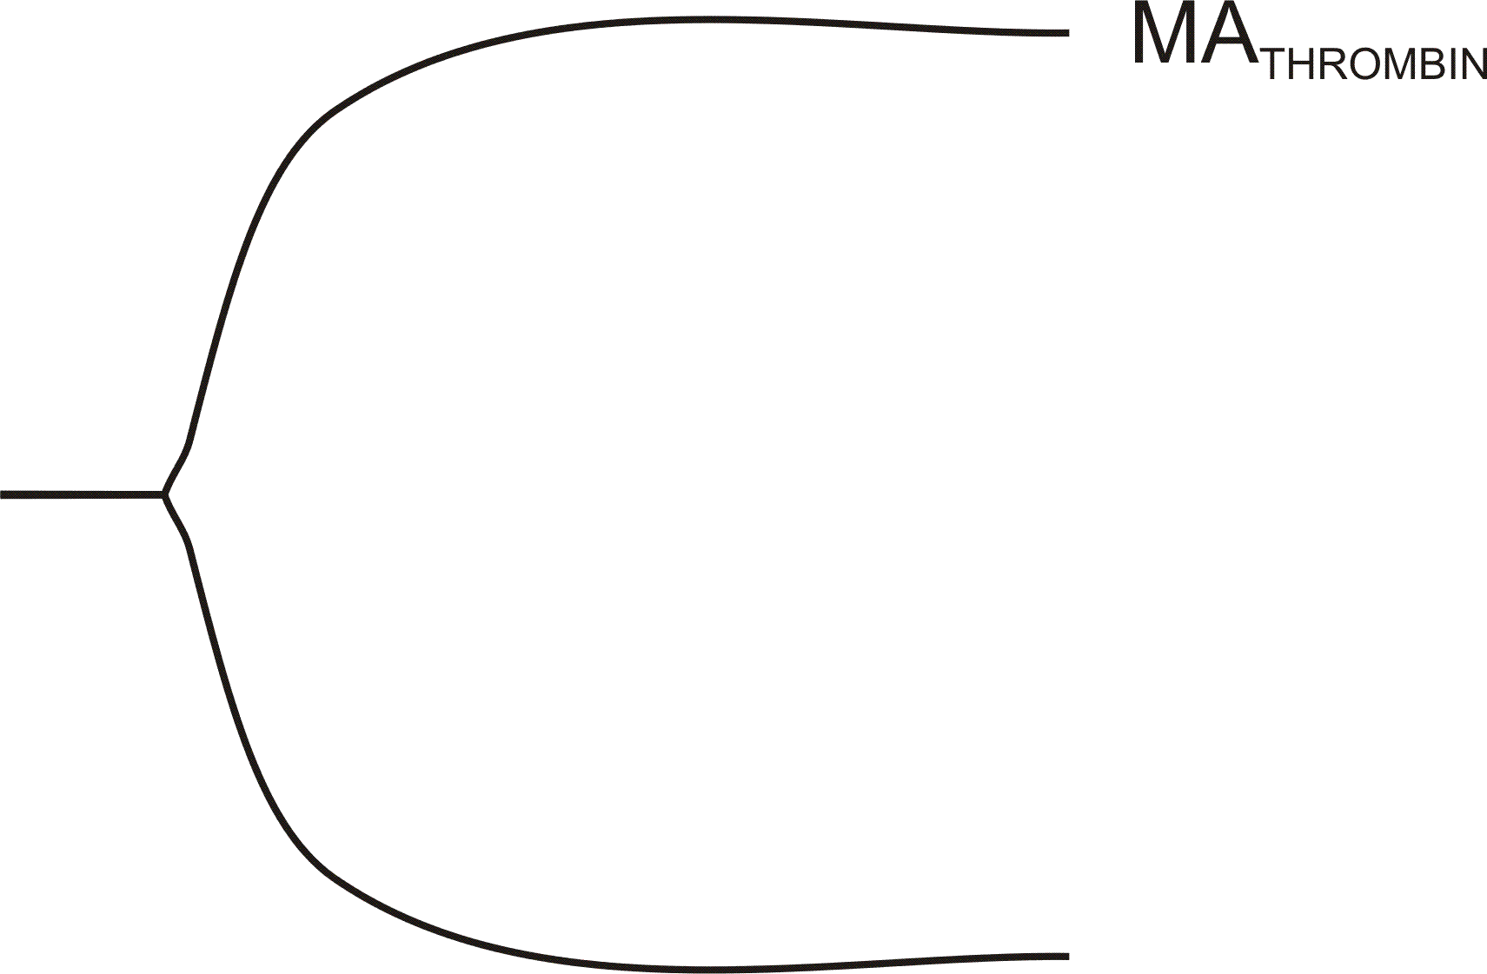
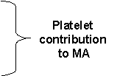
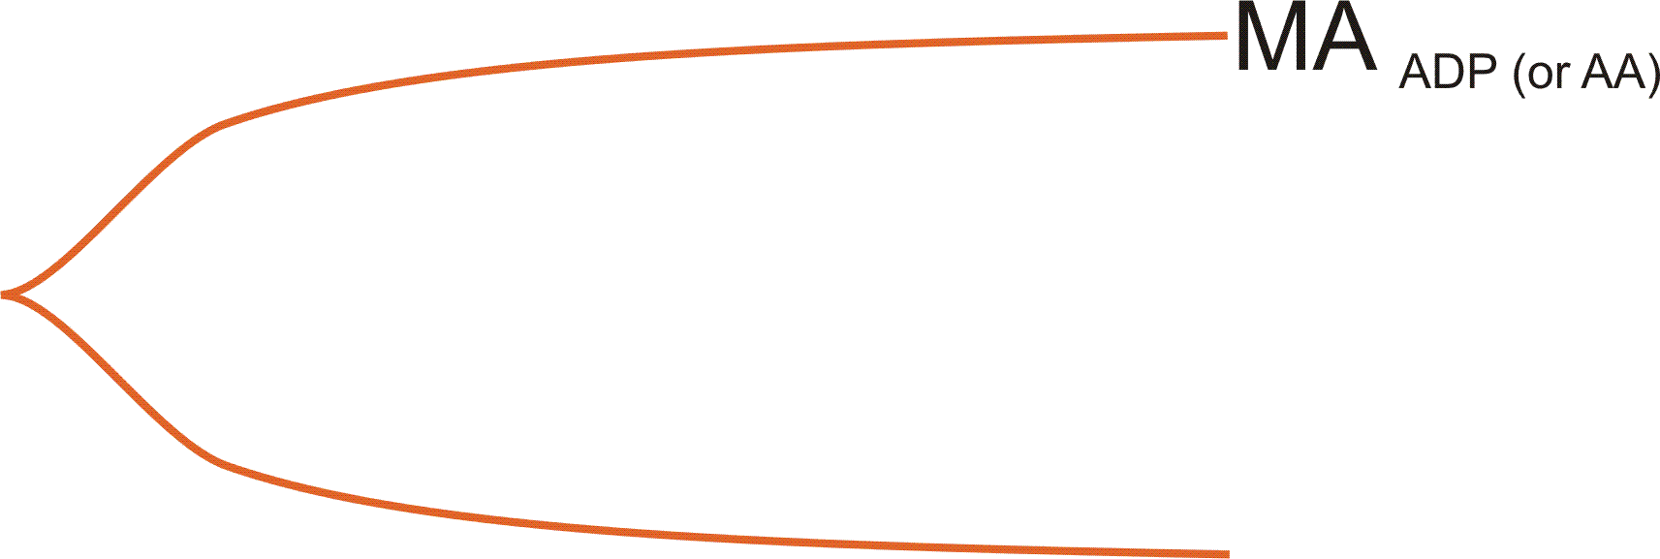
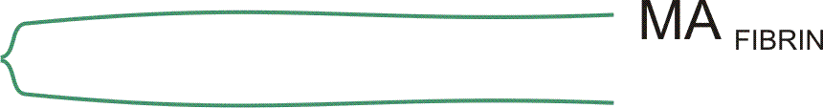
Thrombelastograph Parameters
R (min) - Time to initial fibrin formation induced by thrombin
MA Thrombin - Maximum clot strength induced by thrombin
MA Fibrin - Maximum contribution of fibrin only to MA
MA ADP or A.A - Measures ADP or arachidonic acid stimulated clot strength
R
mm
0
Minutes
Notes:
From the tracing we measured multiple TEG parameters:
1. The time from the start of the sample run to the first
significant level of fibrin generation is the R
time.
2. MA thrombin is a measure of the effect of thrombin-
activated platelet aggregation and fibrin mesh formation on
total clot strength.
3. Fibrin formation alone is stimulated by reptilase in the presence
of heparin.
4. To isolate the platelet contribution to clot strength agonists,
either A.A. or ADP are added in the presence of heparin and
reptilase
5. The responsiveness to a specific drug is calculated by the above
formula. ( pause and point to formula) where Ma thrombin
provides maximum clot strength and MA ADP and MA fibrin
represent the relative contributions of platelet aggregation and f irbrin formation respectively.
6. Clopidogrel non-responsiveness is defined when the MA ADP exceeds
50% maximum platelet aggregation.

Slide 19
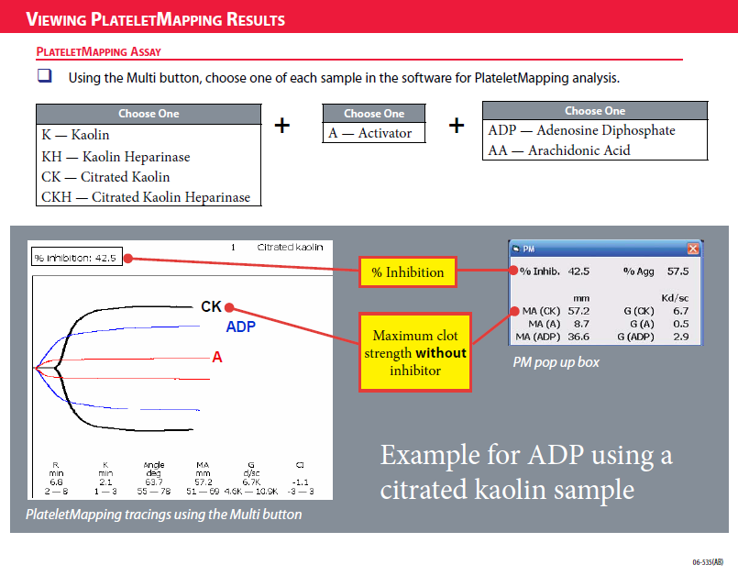

Slide 20
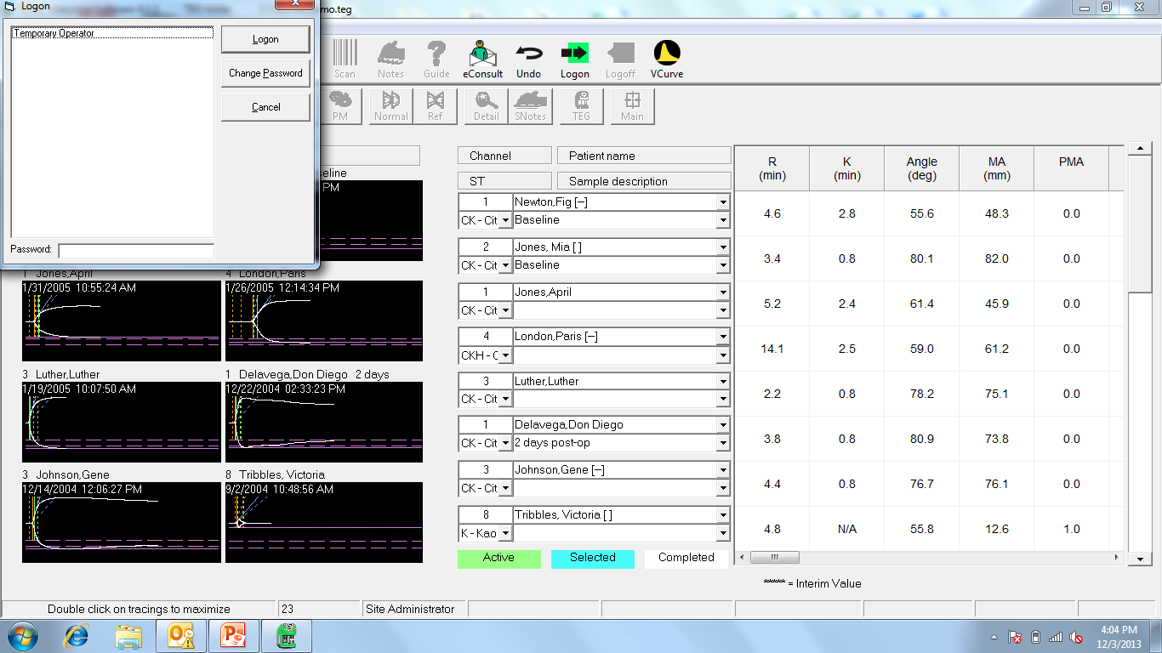
Temporary Operator – click logon (no password required)

Slide 21
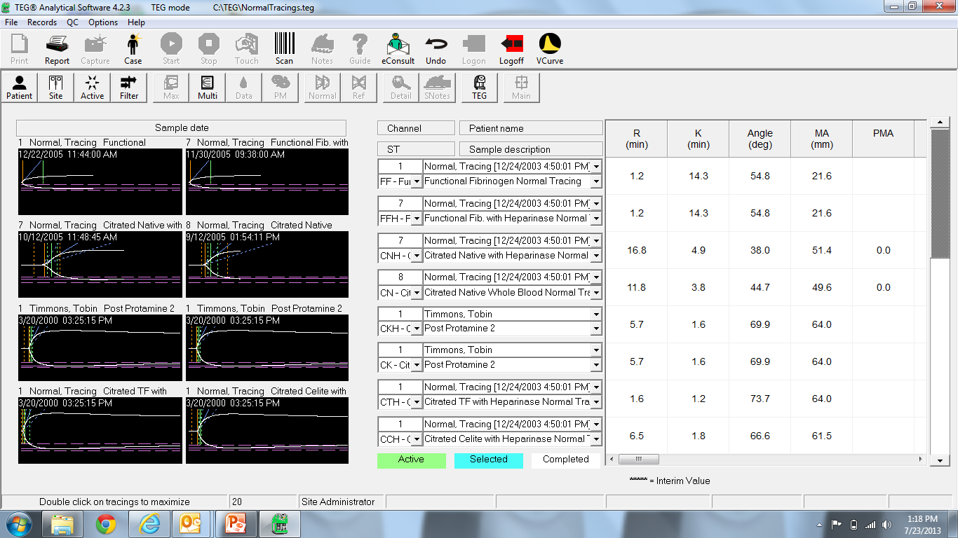
Filter Patient
Filter patient button

Slide 22
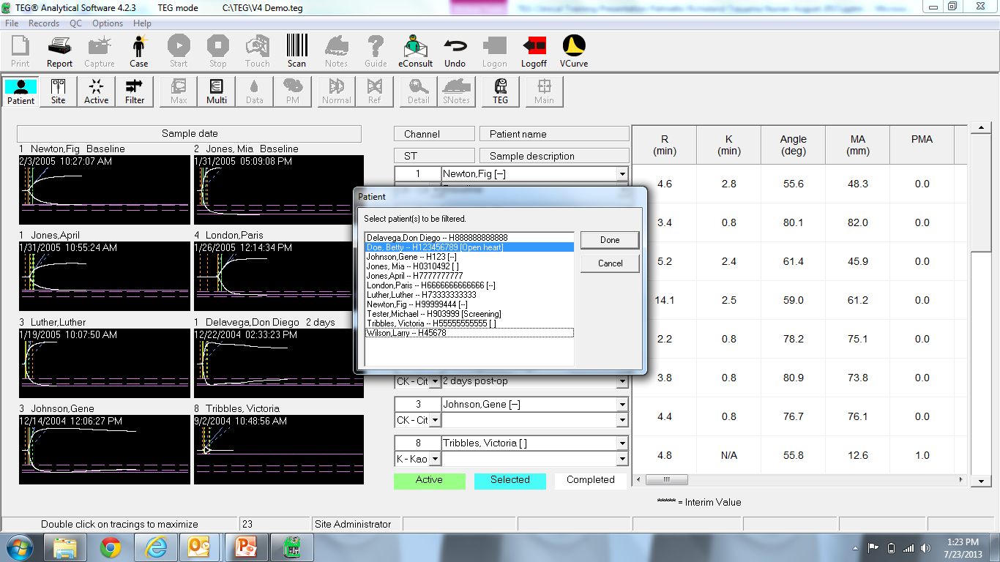
Highlight Patient Name, Click Done

Slide 23
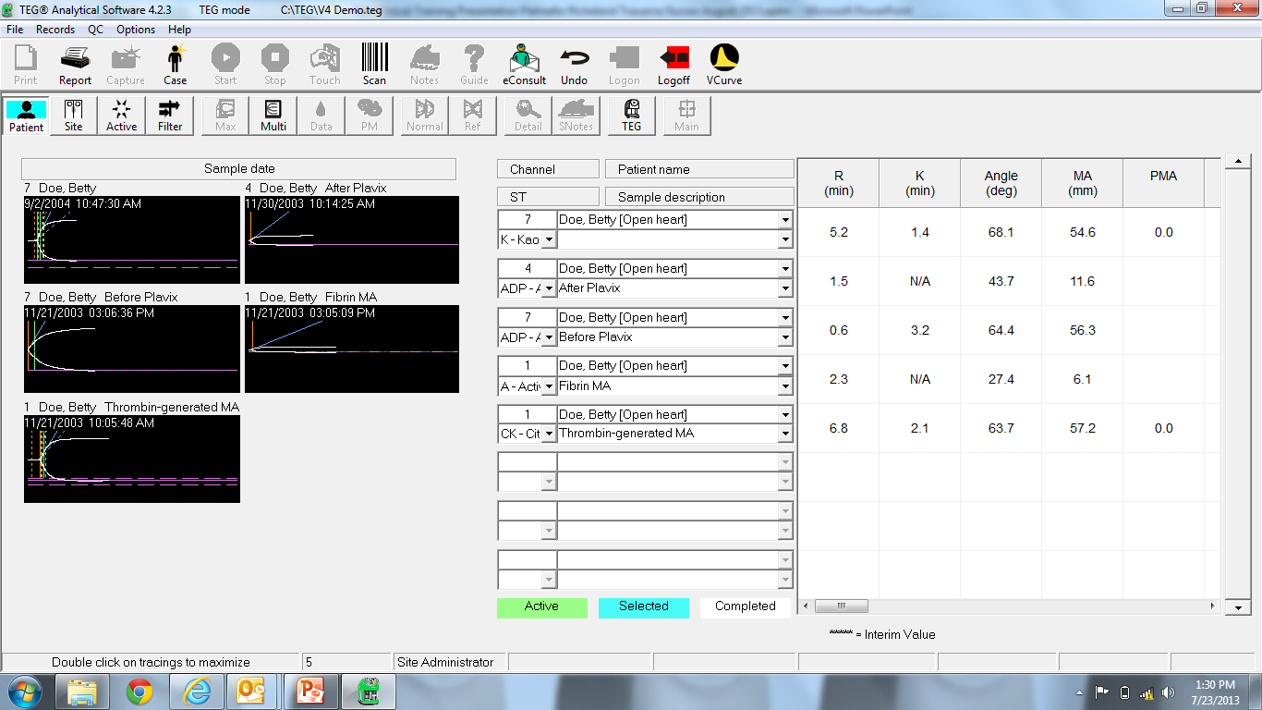
Only See Your Patient’s Tracings

Slide 24
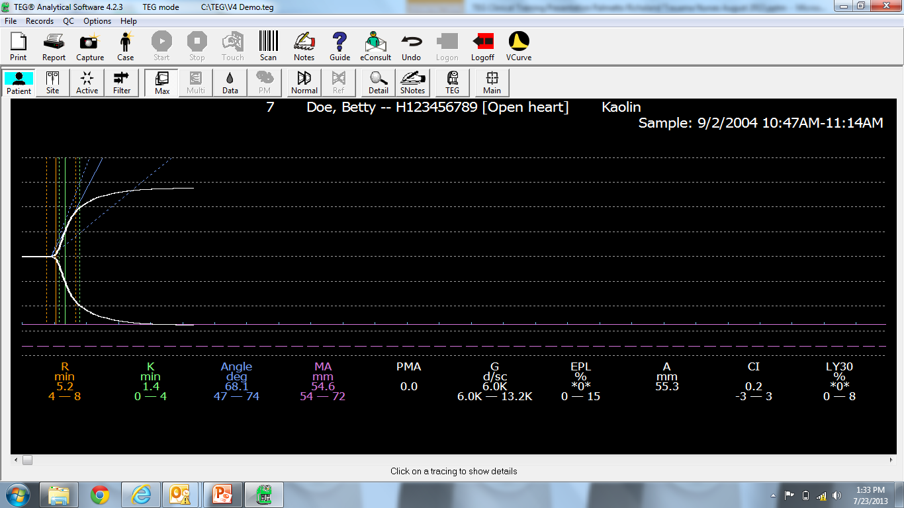
Tracing in Max View

Slide 25
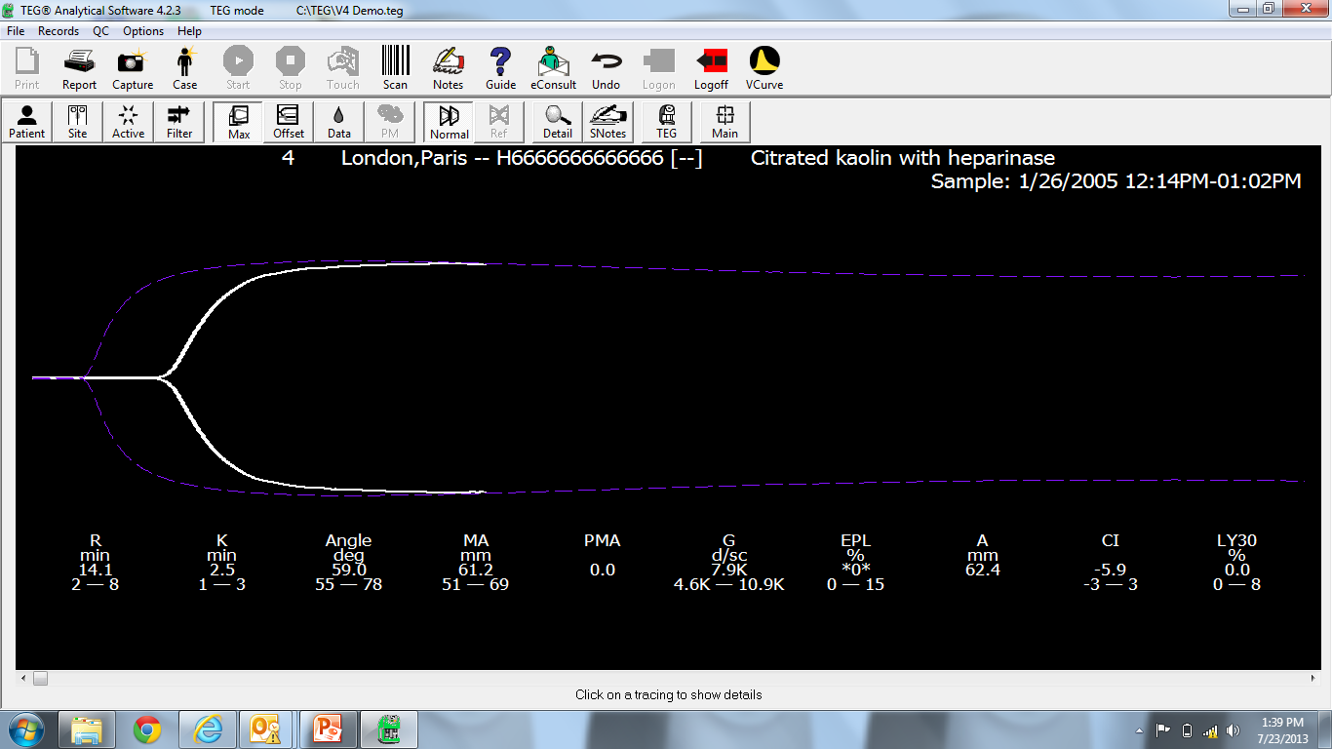
Normal Tracing Overlay

Slide 26
Only See Your Patient’s Tracings

Slide 27
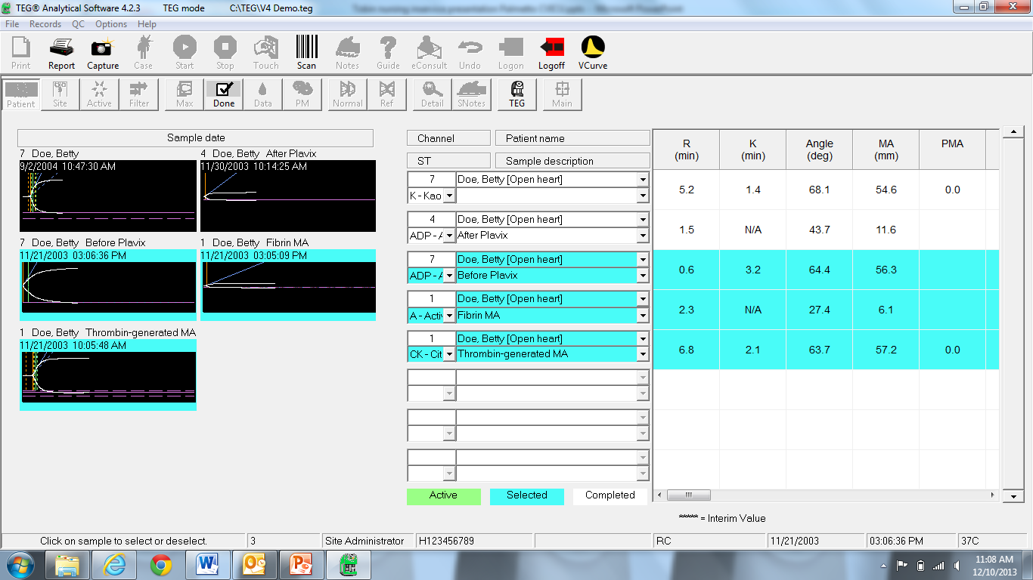
Platelet mapping tracing selection
3
2
1

Slide 28
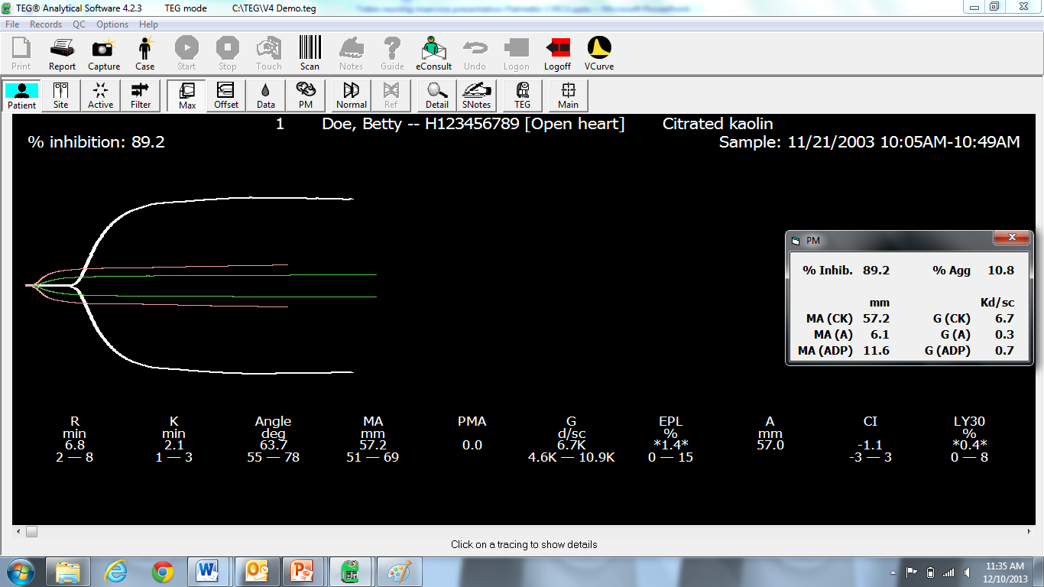
Platelet Mapping Overlay – 89% inhibition
-Apply % inhibition from preop mapping result to subsequent TEG’s post op

Slide 29
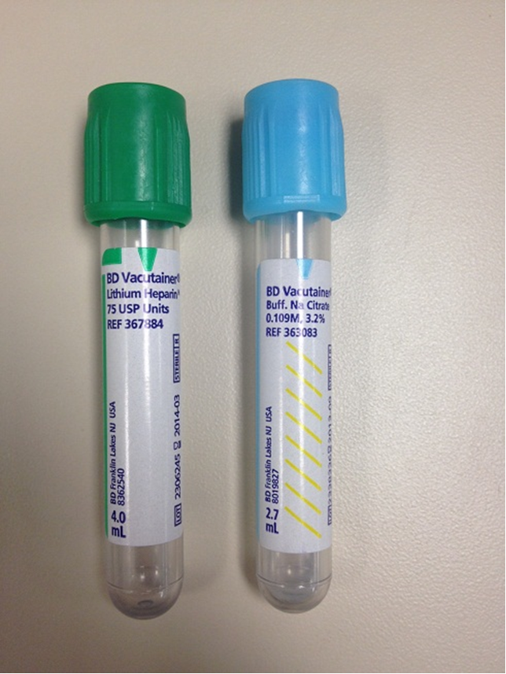
Sample Draw Instructions
Access: A-line or 21g or larger needle
Blue top tube (citrated 1.8ml) x 2
  If platelet mapping – also need dark Green top (sodium or lithium Heparin – NO GEL). Preop or >12hrs post op.
Waste 1st tube if this is the only blood being drawn
Label:
  patient name
  draw time
  TEG or Platelet Mapping
Sample must be hand delivered to Lab – NO TUBING

Slide 30
TEG is normal – patient is bleeding
Consider:
  Was there any inhibition demonstrated on the preop platelet mapping?
  vWF deficiency – often ruled out with DDAVP
  Low Ca+ levels (Ca+ is a cofactor in the coagulation cascade)
  Mechanical bleed - reexploration

Slide 31
Questions?
Thanks for your time!
Tobin Timmons
TEG clinical specialist
850-974-2829

